Slide 1
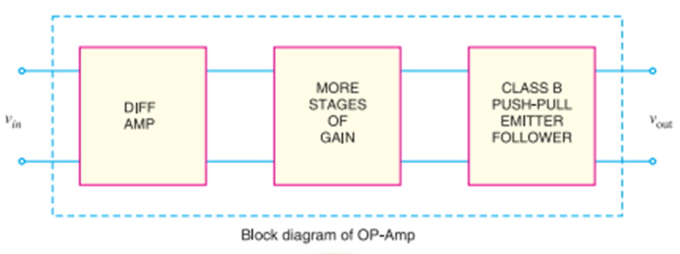
Operational Amplifier
An operational amplifier (OP-Amp) is a circuit that perform mathematical operations such as addition, subtraction, integration and differentiation.
The OP-Amp is a multistage amplifier composed of three stages
differential amplifier as input stage
high-gain CE amplifier and
Class B push pull amplifier as output stage.

Slide 2
The key electronic circuit in an OP-Amp is the differential amplifier.
A differential amplifier accepts two input signals and amplifies the difference between these two input signals.
The internal stages of an OP-Amp are direct-coupled i.e., no coupling capacitors are used.
(The direct coupling allows the OP-Amp to amplify d.c. as well as a.c. signals).
Note:
An OP-Amp has very high input impedance (ideally infinite) and very low output impedance (ideally zero).
The high input impedance causes an amplifier to draw a very small current (ideally zero) from the signal source.

Slide 3
While the very low output impedance causes an amplifier to provide a constant output voltage independent of current drawn from the source.
An OP-Amp has very high *open-loop voltage gain (ideally infinite); typically more than 200,000.
The OP-Amps are always operated with negative feedback in order to achieve the advantages of negative feedback including large bandwidth (BW) and gain stability

Slide 4
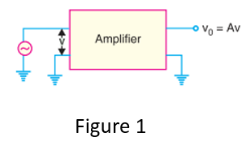
Differential Amplifier (DA)
A differential amplifier is a circuit that accepts two input signals and amplifies the
difference between them.
Fig. 1 Block diagram of an ordinary amplifier.
The input voltage V is amplified to AV where A is the voltage gain of the amplifier. Therefore, the ouput voltage is Vo = AV

Slide 5
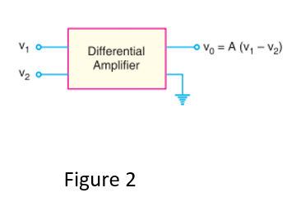
Fig. 2 Block diagram of a differential amplifier.
Usually there are two input voltages V1 and V2.
Therefore, the output voltage is V0 = A(V1 – V2) where A is the voltage gain of the amplifier.

Slide 6
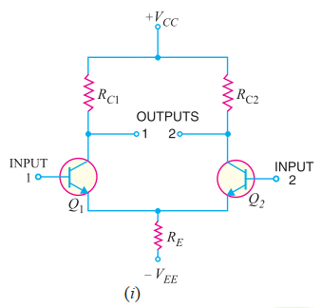
Basic Circuit of Differential Amplifier
Fig. (i) shows the basic circuit of a differential amplifier.
It consists of two transistors Q1 and Q2 that have identical (ideally) characteristics.
And they all share a :
common positive supply VCC,
common emitter resistor RE and
common negative supply VEE.

Slide 7
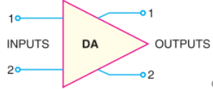
Fig. ii shows the electronic symbol of differential amplifier.
Figure (ii)
The differential amplifier (DA) is a two-input terminal device using atleast two transistors.
There are two output terminals marked 1 (vout 1) and 2(vout 2).
The name is appropriate because the amplifier is amplifying the difference between the two input signals.

Slide 8
The DA transistors Q1 and Q2 are matched so that their characteristics are the same and collector resistors (RC1 and RC2) are also equal.
Note:
The equality of the matched circuit components makes the DA circuit arrangement completely symmetrical.
Two ways of applying signals to a differential amplifier (DA)
(a) The signal is applied to one input of DA while the other input is grounded. In this case, it is called a single-ended input arrangement.
(b) The signals are applied to both inputs of DA. In this case, it is called dual-ended or double-ended input arrangement.

Slide 9
Generally, the differential amplifier (DA) is operated for single-ended output. i.e, the output is taken either from output terminal 1 and ground or from output terminal 2 and ground.
Any input/output terminal that is grounded is at 0V
Output from DA can be taken in the following two ways :
(a) The output can be taken from one of the output terminals and the ground. In that case, it is called single-ended output arrangement.
(b) The output can be taken between the two output terminals (i.e., between the collectors of Q1 and Q2). In that case, it is called double-ended output arrangement or differential output.

Slide 10
Operation of Differential Amplifier
For simplicity, the operation of single-ended input (i.e., signal is applied to one input of DA and the other input is grounded) and double-ended output DA will be considered
(i) Suppose the signal is applied to input 1 (i.e., base of transistor Q1) and input 2 (i.e., base of transistor Q2) is grounded as shown in Fig. 25.5. The transistor Q1 will act in two ways :
as a common emitter amplifier and
as a common collector amplifier.
As a common emitter amplifier, the input signal to Q1 (input 1) will appear at output 1 (i.e., collector of Q1) as amplified inverted signal as shown in Fig. 25.5.

Slide 11
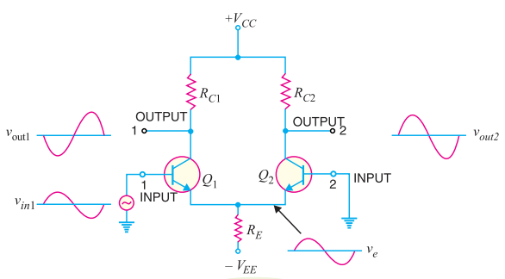
As a common collector amplifier, the signal appears on the emitter of Q1 in phase with the input and only slightly smaller.
Since the emitters of Q1 and Q2 are common, the emitter signal becomes input to Q2. Therefore, Q2 functions as a *common base amplifier. As a result, the signal on the emitter of Q2 will be amplified and appears on output 2 (i.e., collector of Q2) in phase with the emitter signal and hence in phase with the input signal (signal at input 1). This is illustrated in Fig. 25.5

Slide 12
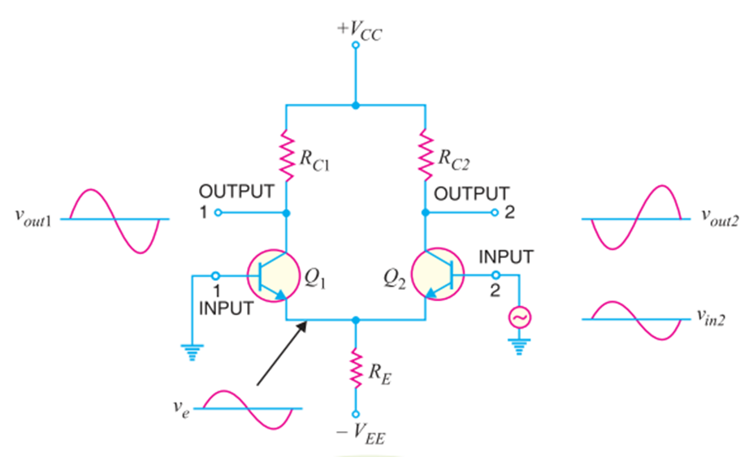
(ii) Now suppose the signal is applied to input 2(i.e., base of transistor Q2) and input 1(base of transistor Q1) is grounded.
As explained above, now Q2 acts as a common emitter amplifier and common collector amplifier while Q1 functions as a common base amplifier.
Therefore, an inverted and amplified signal appears at output 2 (i.e., at collector of Q2) and non-inverted, amplified signal appears at output 1(i.e., at collector of Q1). This is illustrated in Fig. 25.6.

Slide 13
The following points are worth noting about single-ended input DA :
(a) When signal is applied to input 1 (i.e., base of transistor Q1 in Fig. 25.5), an inverted, amplified signal appears at output 1 and non-inverted, amplified signal appears at output2. Reverse happens when signal is applied to input 2 and input 1 is grounded
(b) When only one output terminal is available, the phase of the output of single-ended input DA depends on which input receives the input signal.

Slide 14
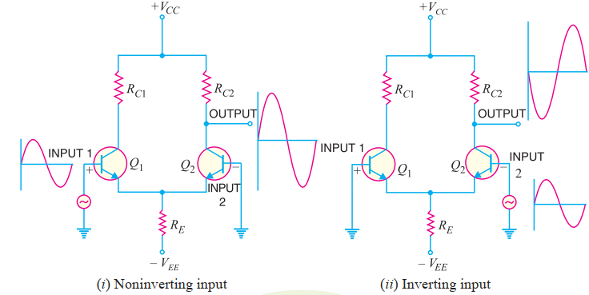
This is illustrated in Fig. 25.7
When signal applied to the input of DA produces no phase shift in the output, it is called noninverting input [See Fig. 25.7 (i)].
In other words, for noninverting input, the output signal is in phase with the input signal.
When the signal applied to the input of DA produces 180° phase shift, it is called inverting input [See Fig. 25.7 (ii)]

Slide 15
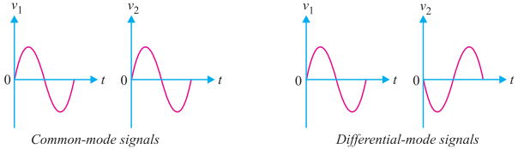
Common-mode and Differential-mode Signals
The importance of a differential amplifier lies in the fact that the outputs are proportional to the
difference between the two input signals.
Thus the circuit can be used to amplify the difference between the two input signals or amplify only one input signal simply by grounding the other input.
The input signals to a DA are defined as :
(i) Common-mode signals (ii) Differential-mode signals
Figure 28

Slide 16
Common-mode signals :
When the input signals to a DA are in phase and exactly equal in amplitude, they are called common-mode signals as shown in Fig. 25.8.
The common-mode signals are rejected (not amplified) by the differential amplifier. It is because a differential amplifier amplifies the difference between the two signals (v1 – v2) and for common-mode signals, this difference is zero. Note that for common-mode operations, v1 = v2.
(ii) Differential-mode signals.
When the input signals to a DA are 180° out of phase and exactly equal in amplitude, they are called differential-mode signals as shown in Fig. 25.9.
The differential-mode signals are amplified by the differential amplifier. It is because the difference in the signals is twice the value of each signal.
For differential-mode signals, v1 = –v2.

Slide 17
Thus the differential amplifier amplifies the differential-mode signals while it rejects the common-mode signals.
Double-ended Input Operation of DA
A differential amplifier (DA) has two inputs so that it can simultaneously receive two signals. The
input signals to a DA are defined as :
(i) Differential-mode signals (ii) Common-mode signals
The differential-mode signals are equal in amplitude but 180° out of phase. The common-mode
signals are equal in magnitude and have the same phase.
(i) Differential input.
In this mode (arrangement), two opposite-polarity (180° out of phase) signals are applied to the inputs of DA as shown in Fig. 25.10 (i).

Slide 18
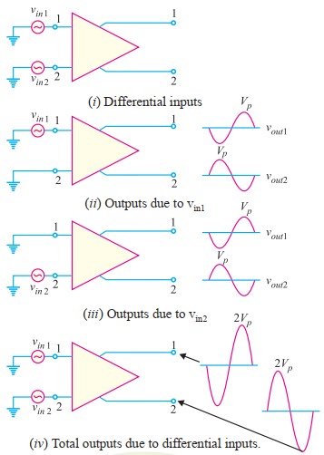
-

Slide 19
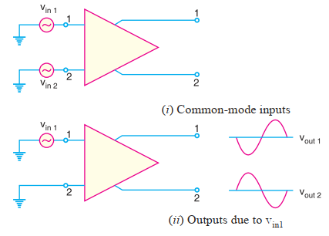
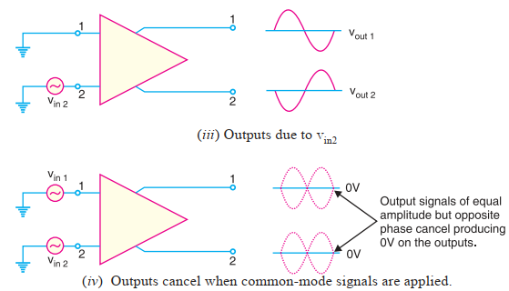
(ii) Common-mode input. In this mode, two signals equal in amplitude and having the same
phase are applied to the inputs of DA as shown in Fig. 25.11(i)

Slide 20
Note It is important to note that common-mode signals are rejected by DA. This action is called
common-mode rejection.
Most of noises and other unwanted signals are common-mode signals.
When these unwanted signals appear on the inputs of a DA, they are virtually eliminated on the output.

Slide 21
Voltage Gains of DA
The voltage gain of a DA operating in differential mode is called differential-mode voltage gain and is denoted by ADM.
The voltage gain of DA operating in common-mode is called common-mode voltage gain and is denoted by ACM.
Ideally, a DA provides a very high voltage gain for differential-mode signals and zero gain for
common-mode signals.
However, practically, differential amplifiers do exhibit a very small common-mode gain (usually much less than 1) while providing a high differential voltage gain (usually several thousands).
The higher the differential gain w.r.t. the common-mode gain, the better the performance of the DA in terms of rejection of common-mode signals.
Thus a differential amplifier should have high differential voltage gain (ADM) and very low common mode voltage gain (ACM).

Slide 22
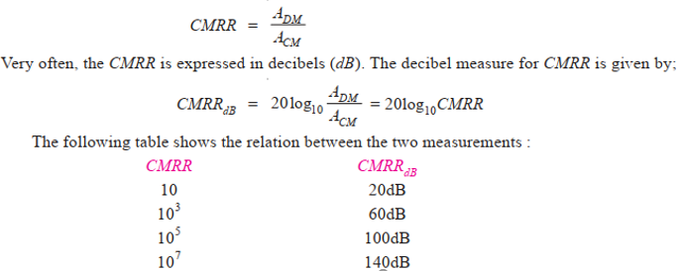
Common-mode Rejection Ratio (CMRR)
The ratio ADM /ACM is called common-mode rejection ratio (CMRR) i.e.,

Slide 23
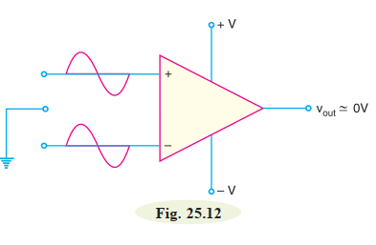
Importance of CMRR.
The CMRR is the ability of a DA to reject the common-mode signals.
The larger the CMRR, the better the DA is at eliminating common-mode signals.
Suppose the differential amplifier in Fig. 25.12 has a differential voltage gain of 1500 (i.e., ADM = 1500) and a common-mode gain of 0.01 (i.e., ACM = 0.01)
CMRR = 1500/0.01 = 150,000

Slide 24
This means that the output produced by a difference between the inputs would be 150,000
times as great as an output produced by a common-mode signal.
The ability of the DA to reject common-mode signals is one of its main advantages.
Common mode signals are usually undesired signals caused by external interference.
For example, any RF signals picked up by the DA inputs would be considered undesirable.

Slide 25
Parameters of DA (or OP–amp) due to Mismatch of
Transistors
Our discussion on the differential amplifier (DA) has been based on the assumption that the transistors are perfectly matched (i.e., they have exactly the same electrical characteristics.)
In practice, this cannot happen. There will always be some difference between the characteristics of the two transistors which leads to the following two parameters of DA (or OP– amp) :
1. Output offset voltage
2. Input offset current

Slide 26
1. Output Offset Voltage.
Even though the transistors in the differential amplifier are very closely matched, there are some differences in their electrical characteristics.
One of these differences is found in the values of VBE for the two transistors.
When VBE1 ≠ VBE2, an imbalance is created in the differential amplifier.
Thus the DA (or OP-amp) may show some voltage at the output even when the voltage applied between two input terminals is zero.
This voltage is called output offset voltage.

Slide 27

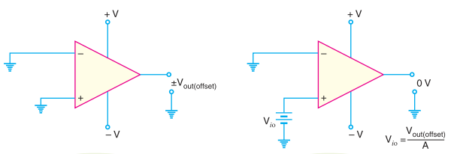
Consider Fig. 25.22, with the inputs of DA grounded, the output shows a measurable voltage. This voltage is a result of the imbalance in the differential amplifier, which causes one of the transistors to conduct harder than the other
There are several methods that may be used to eliminate output offset voltage. One of these is
to apply an input offset voltage between the input terminals of DA (or OP- amp) so as to make
output 0V as shown in Fig. 25.23. The value of input offset voltage (Vi0) required to eliminate the
output offset voltage is given by;
Where A is voltage gain
Figure 25.22

Slide 28
2. Input Offset Current.
When the output offset voltage of a DA (or OP- amp) is eliminated, there will be a slight difference between the input currents to the noninverting and inverting inputs of the device. This slight difference in input currents is called input offset current and is caused by a beta (β) mismatch between the transistors in the differential amplifier.
As an example, suppose IB1 = 75 µA and IB2 = 65 µA.
Then

Slide 29

Input Bias Current
The inputs to an OP- amp require some amount of d.c. biasing current for the transistors in the differential amplifier. The input bias current is defined as the average of the two d.c. base currents
i.e
This means that when no signal is applied, the inputs of OP- amp (i.e., DA) will draw a d.c. current of 80 µA.

Slide 30
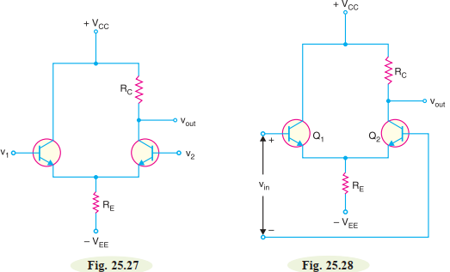
A.C. Analysis of Differential Amplifier
A differential amplifier (DA) has a noninverting input and an inverting input. Fig. 25.27 shows the
differential amplifier (DA) that is used in IC OP- amps. Note the circuit has double-ended input and
single-ended output
The differential amplifier circuit in Fig. 25.27, responds to the difference between the voltages at the two input terminals. i.e. DA responds to vin (= v1 – v2).
Therefore, the circuit shown in Fig. 25.27 can be drawn as shown in Fig. 25.28

Slide 31
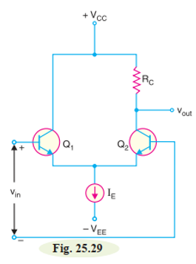
Ideally (i.e., VBE is negligible), the tail current IE in Fig. 25.27 is IE = VEE/RE.
Once the values of VEE and RE are set, the tail current is constant.
Therefore, to simplify a.c. analysis, we can replace the tail current by a current source (IE) as shown in Fig. 25.29. This will simplify the a.c. analysis of the circuit with almost no loss of accuracy

Slide 32
A.C. Equivalent Circuit.
The a.c. equivalent circuit of differential amplifier can be obtained by applying the usual rules to Fig. 25.29.
short all the capacitors, and
reduce all d.c.sources to zero.
Since a differential amplifier has no capacitors, just reduce the d.c. sources to zero.
Reducing a voltage source to zero is equivalent to replacing it by a short.
Reducing a current source to zero is equivalent to opening it.
Ground the VCC point, ground the VEE point and open the current source.
Applying these conditions to Fig. 25.29, we get the a.c. equivalent circuit of differential amplifier shown in Fig. 25.30.

Slide 33
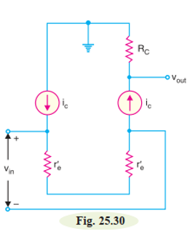
Voltage gain.
Fig. 25.30 shows the a.c. equivalent circuit of a differential amplifier.
Note that r′e (= 25 mV/d.c. emitter current) is the a.c. emitter resistance.
Since the two r′e’s are in series, the same a.c. emitter current exists in both transistors.

Slide 34
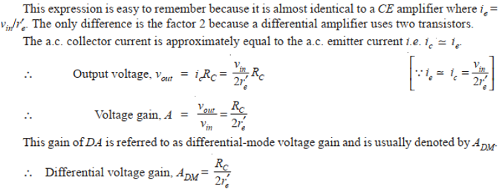
The a.c. emitter current is given by;

Slide 35
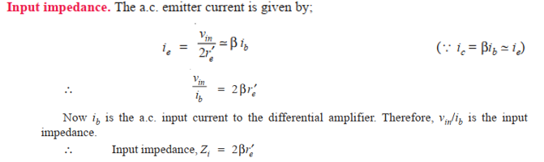

Slide 36
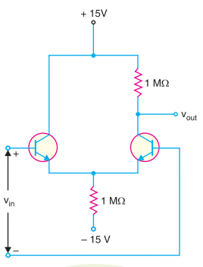
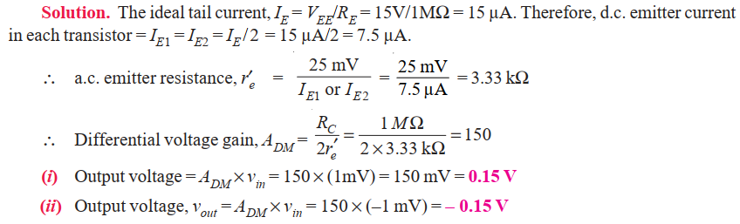
Example What is Vout in Fig. 25.31 when (i) Vin = 1mV (ii) Vin = –1mV ?
Figure 25.31

Slide 37
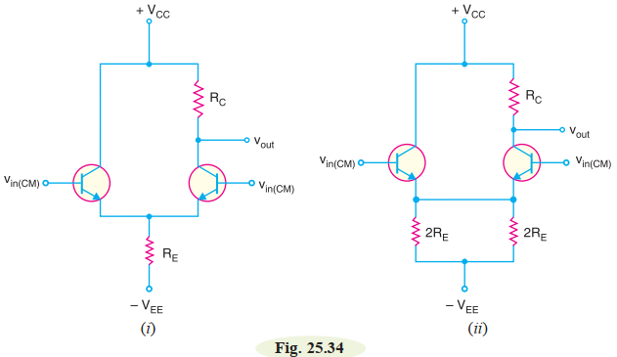
Common-mode Voltage Gain (ACM)
The common-mode signals are equal in amplitude and have the same phase.
Fig. 25.34(i) shows the common-mode operation of a differential amplifier (DA). Note that the same input voltage, Vin(CM) is being applied to each base.
Ideally, there is no a.c. output voltage with a common-mode input signal.
It is because a differential amplifier is designed to respond to the difference between two input signals.
If there is no difference between the inputs, the output of DA is zero.
In practice, the two halves of the differential amplifier are never completely balanced and there is a very small a.c. output voltage for the common-mode signal.

Slide 38
The circuit shown in Fig. 25.34(i) can be redrawn as shown in Fig. 25.34(ii). In this equivalent circuit, the two parallel resistances of 2 RE produce an equivalent resistance of RE. Therefore, this
equivalent circuit will not affect the output voltage. Assuming identical transistors, the two emitter currents will be equal and produce the same voltage across emitter resistors. Therefore, there is no
current through the wire between the emitters. We can remove this wire and the circuit becomes as shown in Fig. 25.35 (i).
A.C. equivalent circuit
To get the a.c. equivalent circuit, we can reduce both supply voltages to zero i.e., we ground each supply point. Replacing the transistors by their a.c. equivalent circuits,
we get a.c. equivalent circuit of differential amplifier for commom-mode operation as shown in Fig. 25.35 (ii).

Slide 39
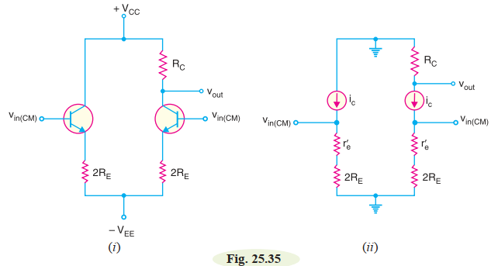

A.C. equivalent circuit

Slide 40
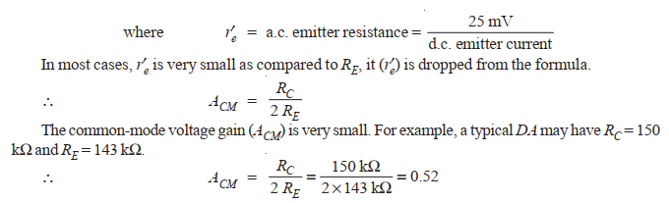
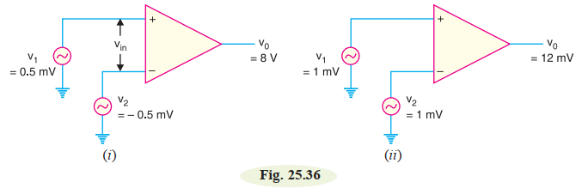
Example 2 Calculate the CMRR for the circuit measurements shown in Fig. 25.36.

Slide 41
The following are the important properties common to all operational amplifiers (OP-amps):
An operational amplifier is a multistage amplifier. The input stage of an OP-amp is a
differential amplifier stage.
An inverting input and a noninverting input.
A high input impedance (usually assumed infinite) at both inputs.
A low output impedance (< 200 Ω).
A large open-loop voltage gain, typically 105.
The voltage gain remains constant over a wide frequency range.
Very large CMRR (> 90 dB).

Slide 42
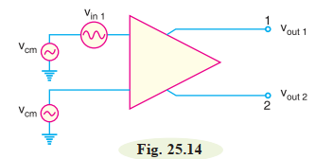
HW
The differential amplifier shown in Fig. 25.14 has a differential voltage gain of
2500 and a CMRR of 30,000. A single-ended input signal of 500 µV r.m.s. is applied. At the same
time, 1V, 50 Hz interference signal appears on both inputs as a result of radiated pick-up from the
a.c. power system.
(i) Determine the common-mode gain.
(ii) Express the CMRR in dB.
(iii) Determine the r.m.s. output signal.
(iv) Determine the r.m.s. interference voltage on the output

